Slide 1
Undecentralized Personal Digital Data
Alon Halevy
Meta, Reality Labs Research
August 27, 2023

Slide 2
Why Care About Personal Data?
We create personal digital data throughout our day.
Significant attention on: what are corporations doing with this data?
Our interest: what are we doing with our data?
The ideas on personal data date back to Vannevar Bush in 1945.
MyLifeBits (Gordon Bell @MSR) and many other projects since.
Our life is even more digital now:
Always-on perception (smart glasses) may be coming.
Personal AI assistants may be coming.

Slide 3
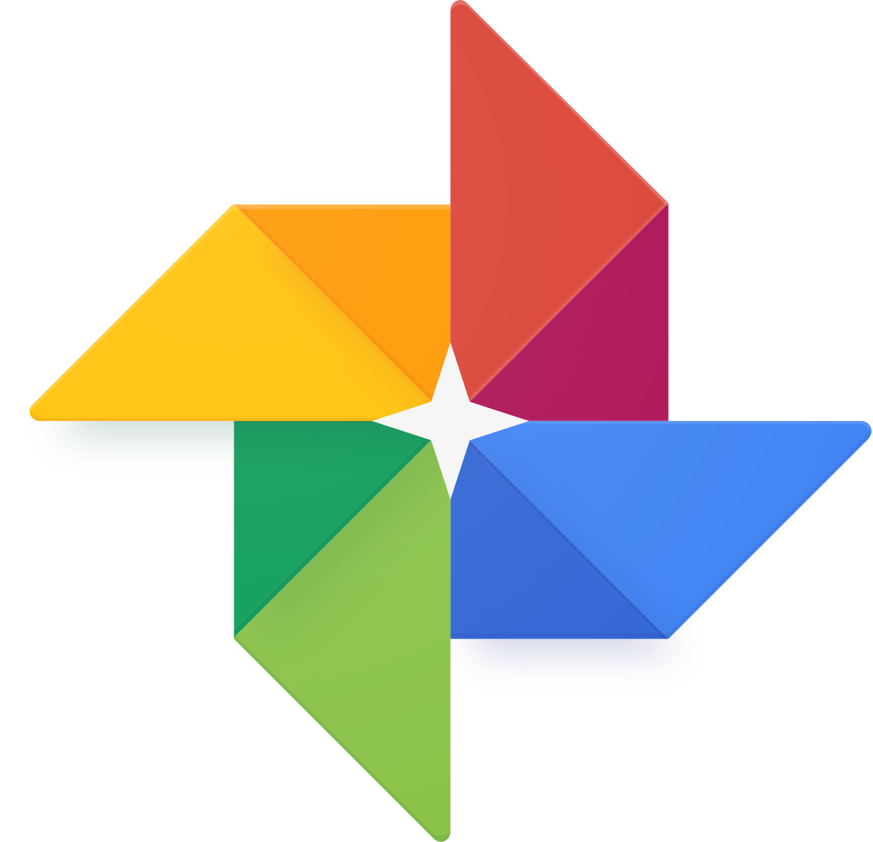


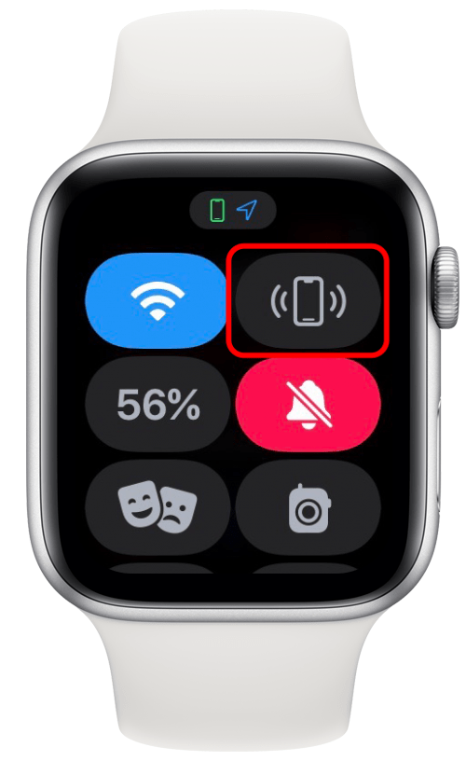
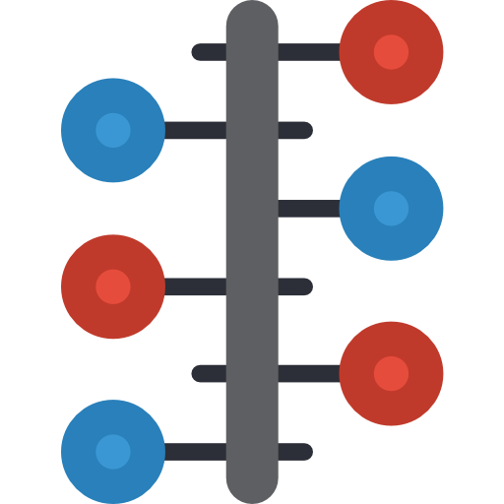
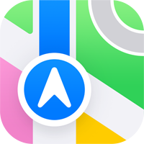
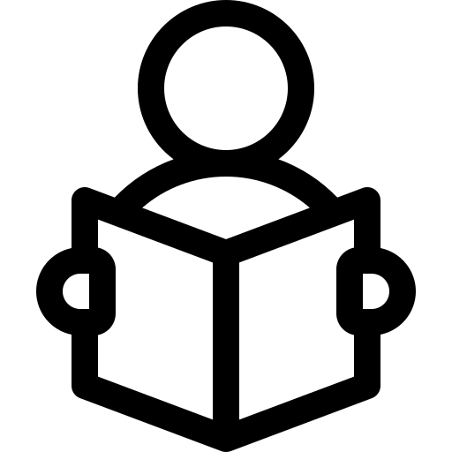



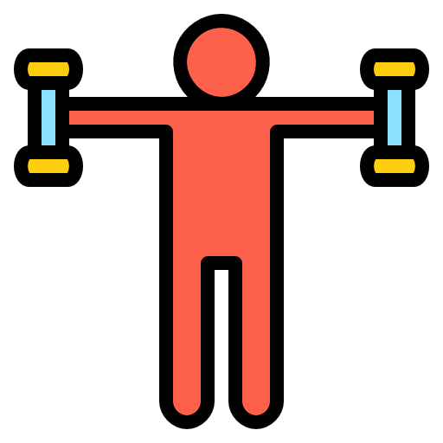

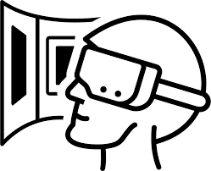
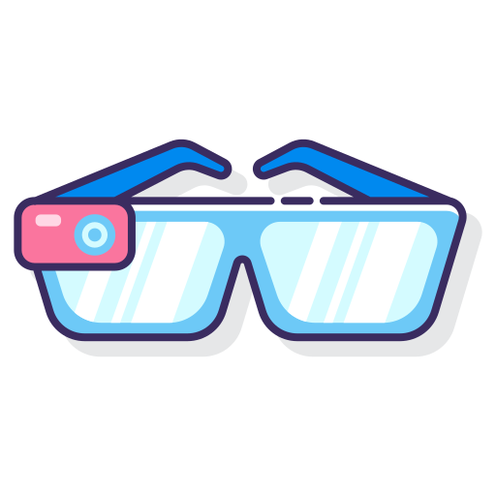

Imagine an Eco-System of Personal Data
Personal digital data
Personal timeline
Smaller summaries of me
Interactions in the digital world
When did I go to Tokyo? Where did I run when I was in Tel-Aviv? How many books did I read last year?

Slide 4
Importing Data
Possible, thanks to GDPR. DMA will make it easier.
We don’t need to import all the data
New toys will give us more kinds of data:
Sleep trackers
Smart clothing
Brain-computer interfaces
Also include “Projectories and Subjectories”

Slide 5
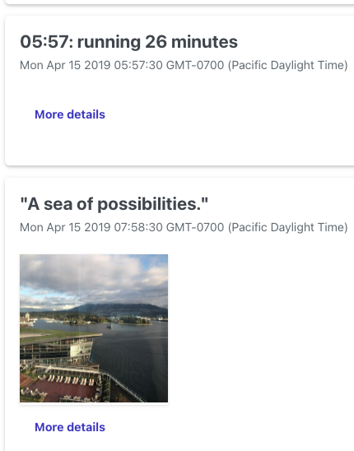
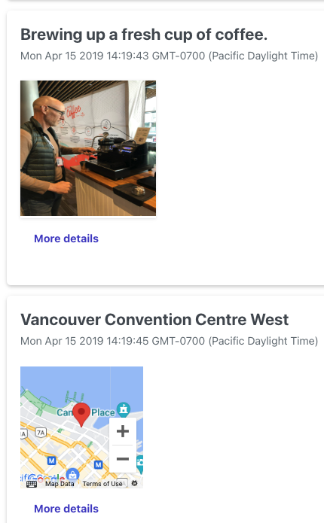
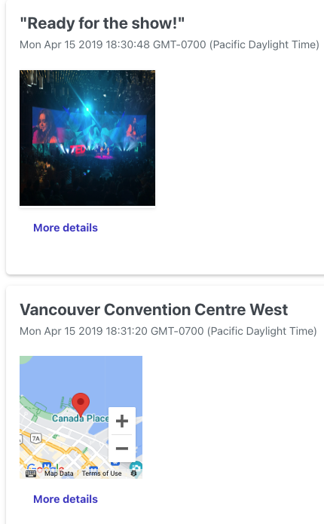
TimelineBuilder github.com/facebookresearch/personal-timeline
Alon’s April 15, 2019, in Vancouver.
Started the day with a run
Attended a conference
Enjoyed coffee
Went for a show in the evening

Slide 6
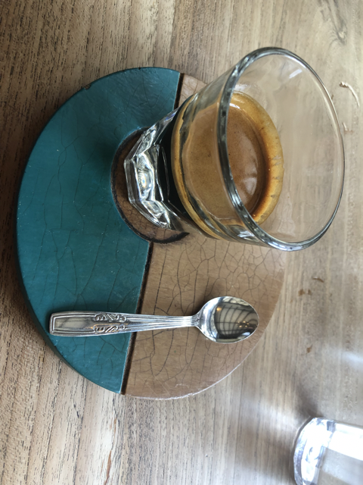

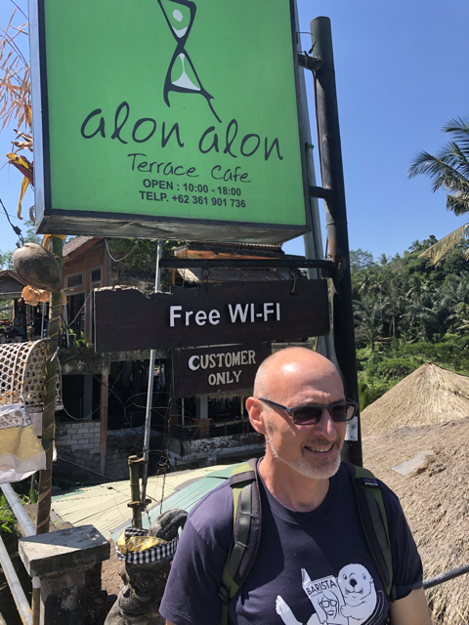
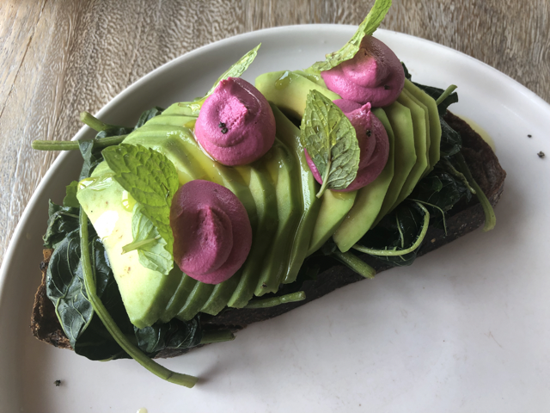
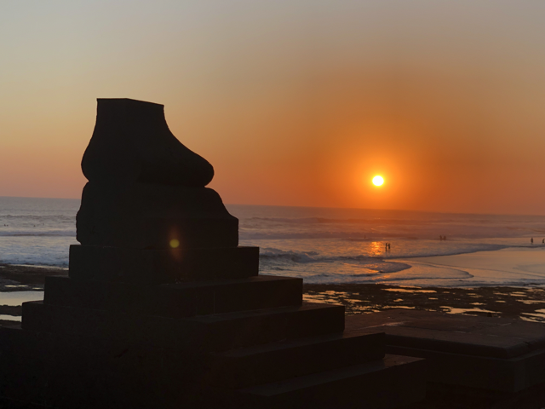
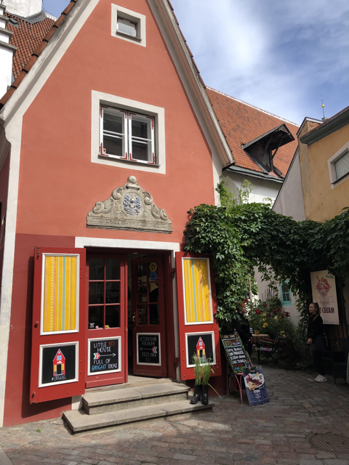
Fusing Data to a Timeline: a database of Episodes
Highschool graduation
Trip to Tokyo
Fun with the kids
Born
Got tenure
Left academia
Every episode has a start/end time and location.
Important to compute the experienced time.
No other structure required.
Why is fusion important? Because data sources complement each other.

Slide 7
Some of the Technical Challenges
Deriving episodes -- the raw data doesn’t tell the whole story
Lots of photos from Tokyo → but the real itinerary is not explicit
Photos and shopping receipts → but it was really a birthday party (and prep)
A video of your day → ???
Querying timelines:
“Where did I take my mom when she came to Seattle?”
Will LLMs be able to answer these questions alone? (not if you ask a database person!)
TimelineQA: a synthetic benchmark to start investigating QA [Tan et al., ACL 2023]
How can we train models to answer these queries?

Slide 8
How do we develop this vision securely?
The data should be stored securely and available only to you.
Sharing slices of the data should be on the fly and in language:
Share my eating preferences with this waiter for the next 10 minutes
Share the itinerary of my trip to Hong Kong with Julia
What happens with shared experiences? (e.g., couples, families)
How do we protect users from overreach by institutions?

